Slide 1
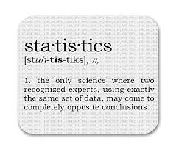

Introduction to Statistics: what? when? why?
4ECON006C: Fundamentals of Statistics
Olmos Isakov
o.isakov@wiut.uz

Slide 2




Module team
Olmos Isakov – module leader
o.isakov@wiut.uz
Salim Turdaliev
sturdaliev2@wiut.uz
Farrukh Ataev
fataev@wiut.uz
Yermone Sargsyan
ysargsyan@wiut.uz
Zohid Askarov
z.askarov@wiut.uz
Gayrat Suyunov
gsuyunov2@wiut.uz

Slide 3
Module content and assessment
Key topics
Probability theory
Descriptive statistics
Hypothesis testing
Analysis of variance
Categorical data analysis
Correlation analysis
Regression analysis

Slide 4
Module content and assessment
Assessment
Portfolio assignments (1 per semester) 20%
Mid-term test 40%
Final exam 40%

Slide 5
Main textbook

Slide 6


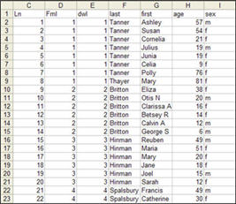


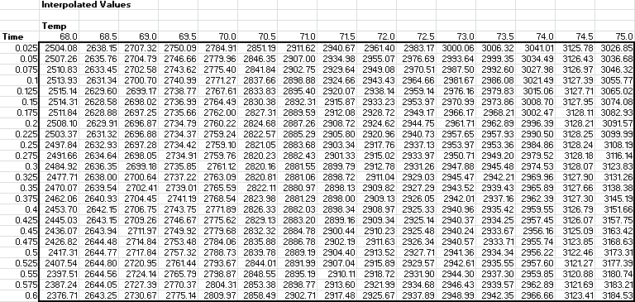

Fundamentals of Statistics
collecting
Data
Making inferences, conclusions
presenting
analysing

Slide 7
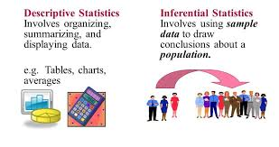
Descriptive Statistics | Inferential Statistics
Concerned with the describing the target population | Makes inferences from the sample and generalizes about population
Organizes, analyzes and presents the data in a meaningful manner | Tries to make conclusions about the population that is beyond the available data
Tools – Measures of central tendency (mean/median/mode), spread of data (range, standard deviation, etc ) | Tools – hypothesis tests, analysis of variance, regression, etc

Slide 8
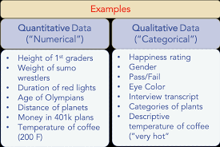
Types of data
A quantitative (numerical) data takes numerical values for which arithmetic operations such as adding and averaging make sense.
A categorical (qualitative) data places a case into one of several groups or categories.

Slide 9
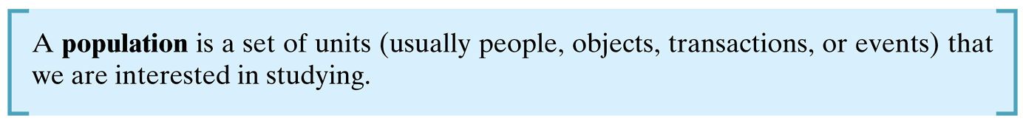
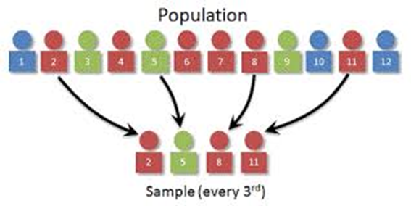
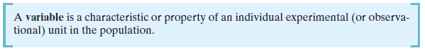
Key definitions

Slide 10

Observational study vs designed experiment
An observational study is a data collection method where the experimental units sampled are observed in their natural setting.
A designed experiment is a data collection method where the researcher exerts full control over the characteristics of the experimental units sampled.

Slide 11
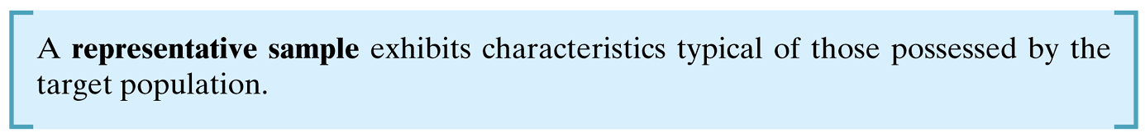
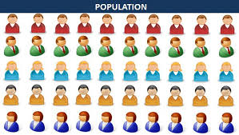
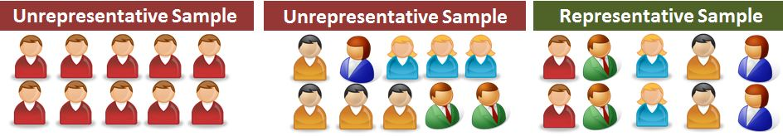
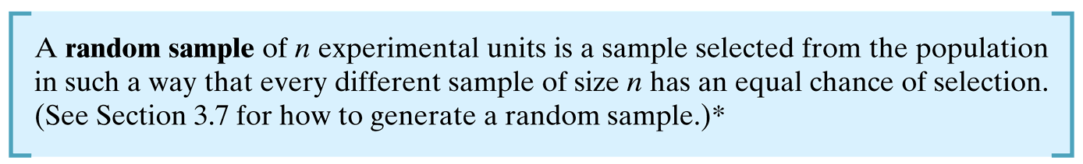

Slide 12

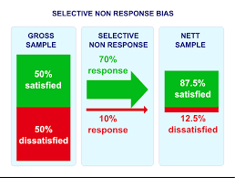
Non-random samples
Selection bias results when
a subset of the experimental units in
the population is excluded so that
these units have no chance of being
selected in the sample.
Nonresponse bias results when the
researches conducting a survey or
study are unable to obtain data on
all experimental units selected for
the sample.

Slide 13
References
Chapter 1. McClave & Sincich. Statistics.
Chapter 1. Holmes et. al. Introductory Business Statistics.

